Slide 1

The 20-Ghost Club Limited
The Oldest Rolls-Royce Car Club in the World
Strategy Review
2015

Slide 2
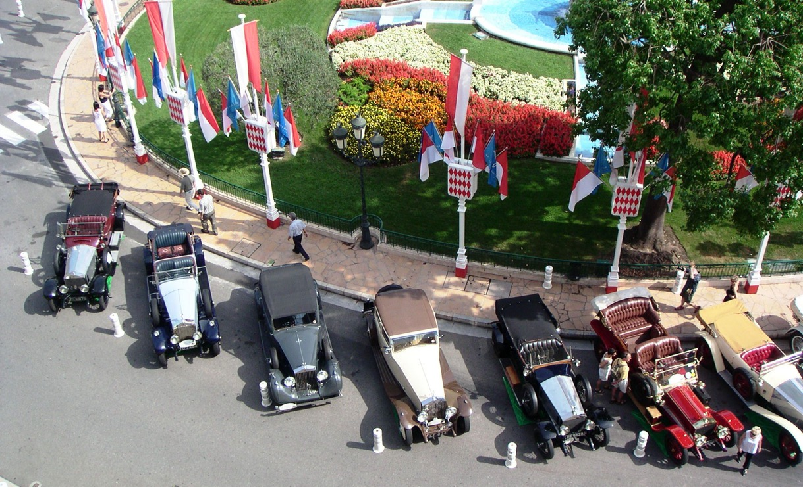
The 21st C 20 Ghost Club: Core Values
Inclusive but Exclusively pre 1940

Slide 3

The 21st C 20 Ghost Club: Core Values
At Heart a Touring & Driving Club

Slide 4
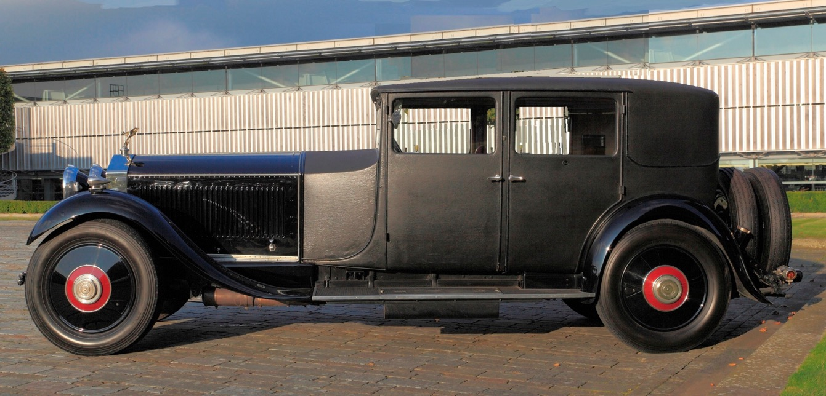
The 21st C 20 Ghost Club: Core Values
Appreciation & Conservation of fine cars

Slide 5
The Kind of Club we want to be in the 21st Century
1 a. Fundamental aim to focus on Pre 1940 Cars?
1 b. The Club’s USP is offering really interesting driving tours and events?
1 c. events to offer challenge and interest for all sizes of car and all ages and sexes of participant?
1 d. most pre 1939 Rolls-Royce owners to be members
1e. retain excellent high end events and at the same time organise a wider range of shorter events including some with more action and involvement?

Slide 6
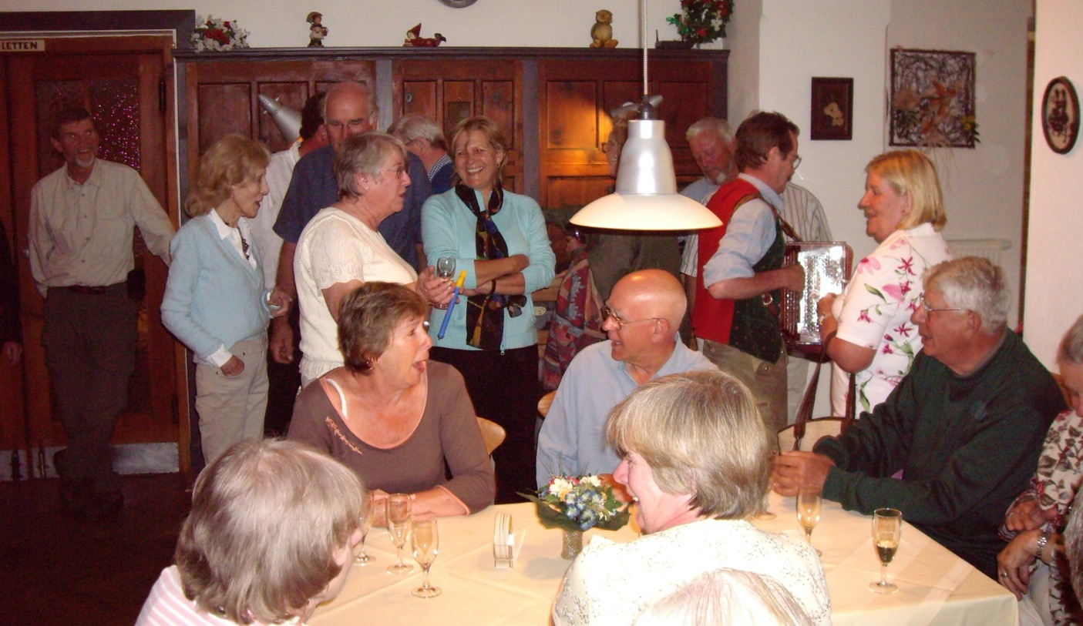
Tours & Events – Key Success Factors
- Camaraderie

Slide 7
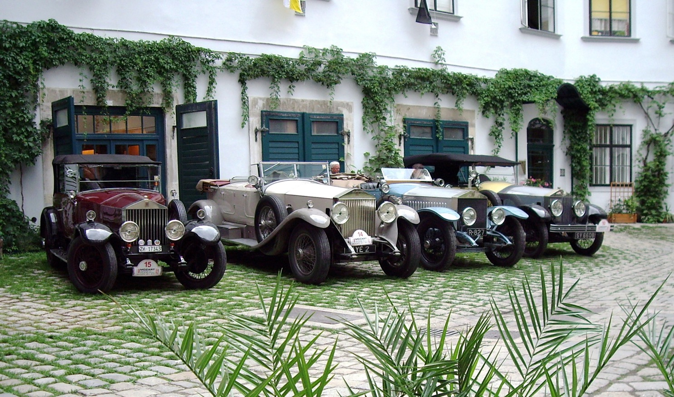
Tours & Events – Key Success Factors
Variety of Models

Slide 8
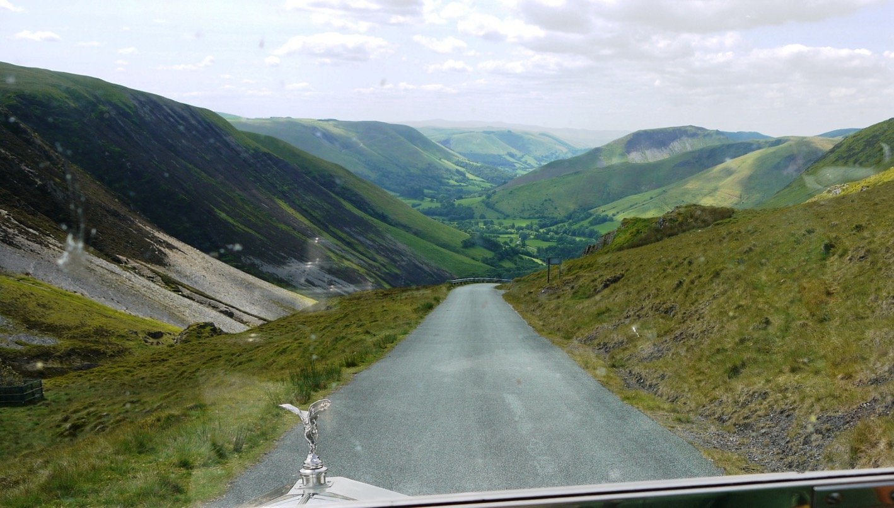
Tours & Events – Key Success Factors a little bit of challenge

Slide 9
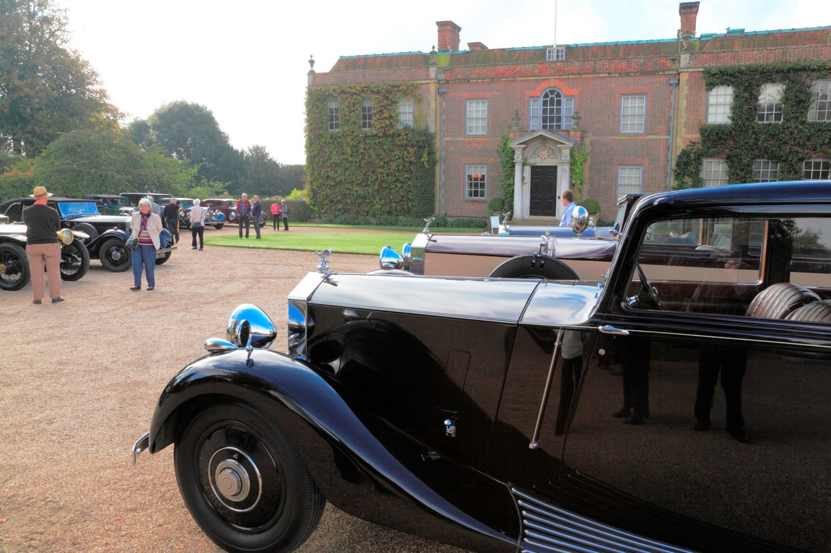
Tours & Events – Key Success Factors
Special Access to wonderful places

Slide 10
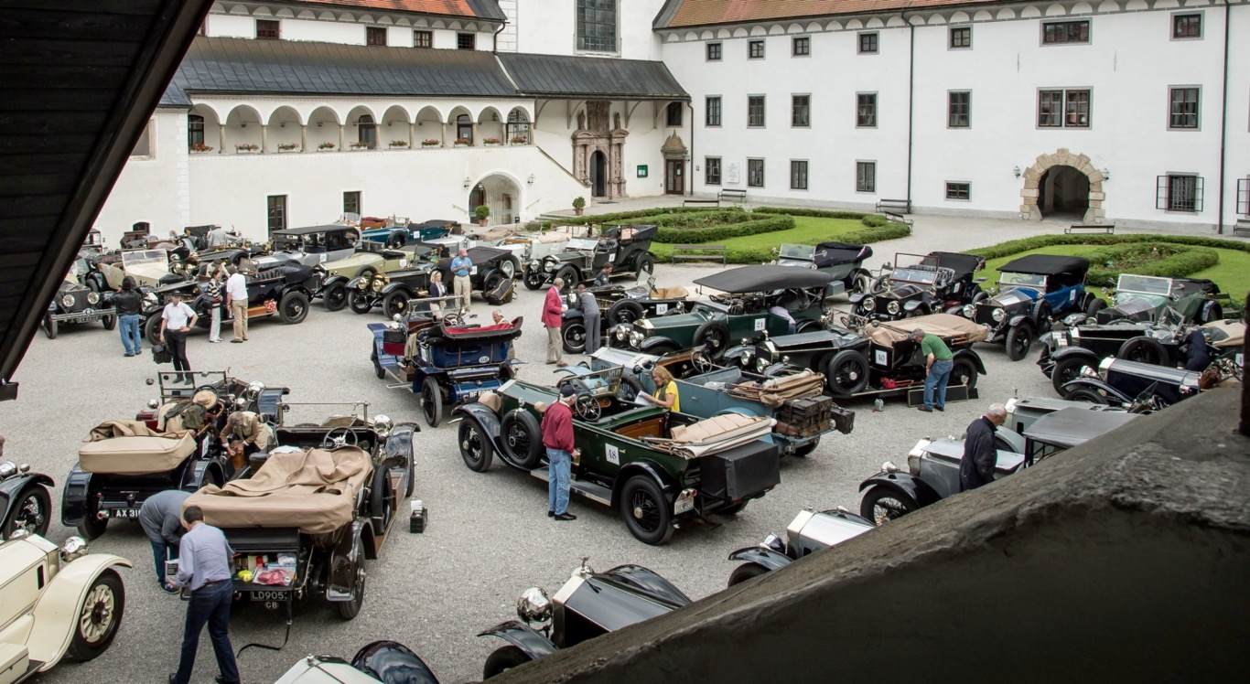
Tours & Events – Key Success Factors End of day; feeling of achievement

Slide 11
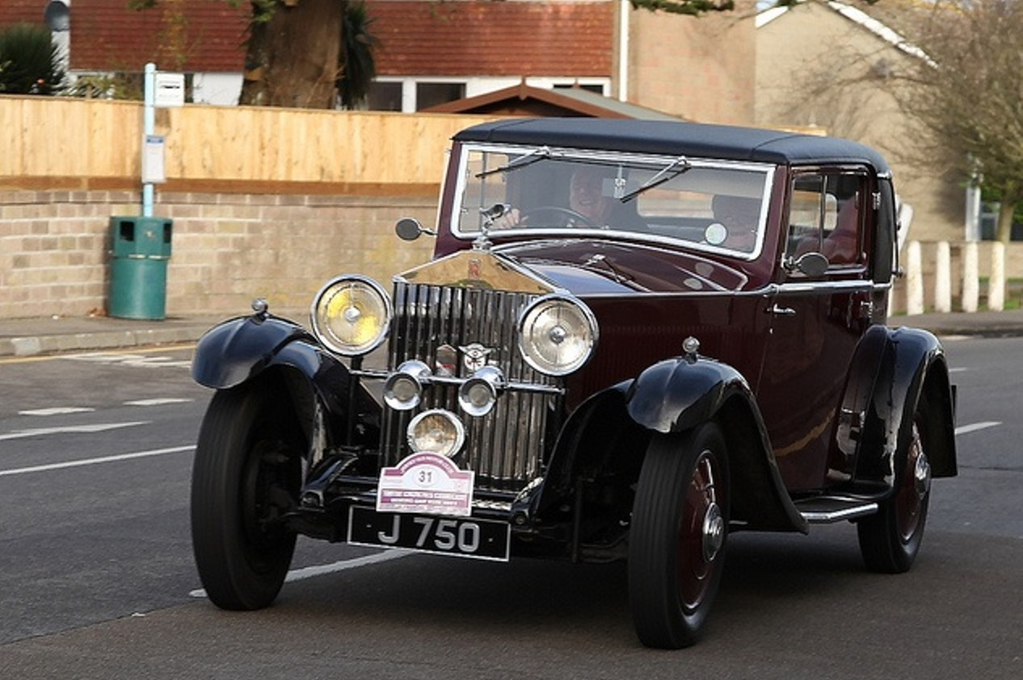
Tours & Events – Model Specific ?

Slide 12
Tours & Events – Decisions
2.a broaden the scope of events in line with the original uses of our cars?
2.b continue to run Flagship events and how often?
2.c When to restrict certain events to certain models?
2.d Monitor the success of a different types of tour to attract members?
2.e more Action oriented events?
2.f more one day events?
2.g invite individuals to organise regional events both in the UK and on the Continent ?
2.h central assistance to enable members to organise more local events?
2.i partner with clubs & organisations to offer our members a wider range ?
2.j Use tour operators to assist in planning and organising tours so we can offer a wider range ?
2.k guidelines so cost of events matches the nature of the event and represents good value ?

Slide 13
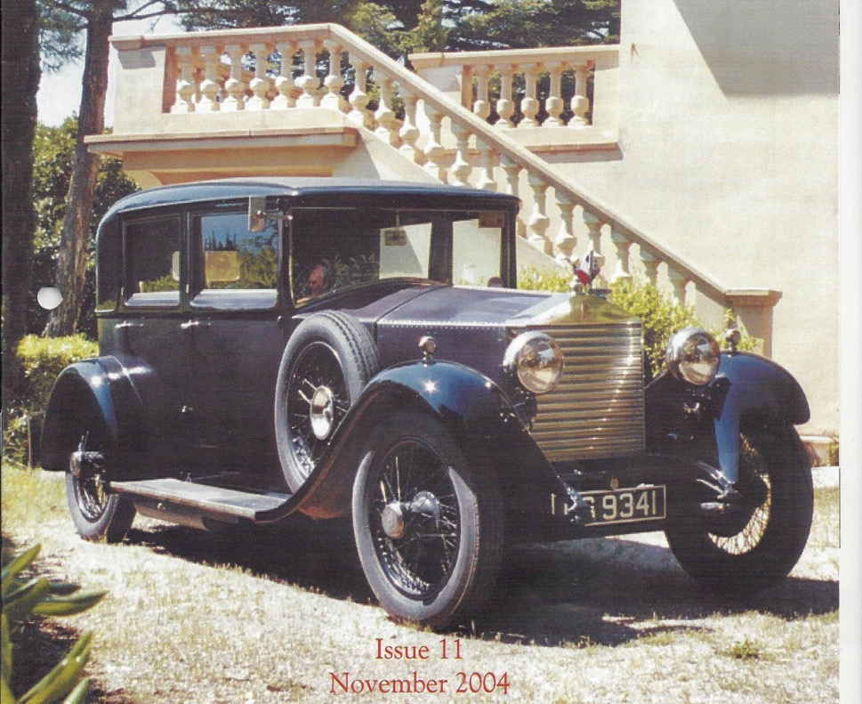
Membership: Participation ?
20 HP: 22% of cars -4% of participants

Slide 14
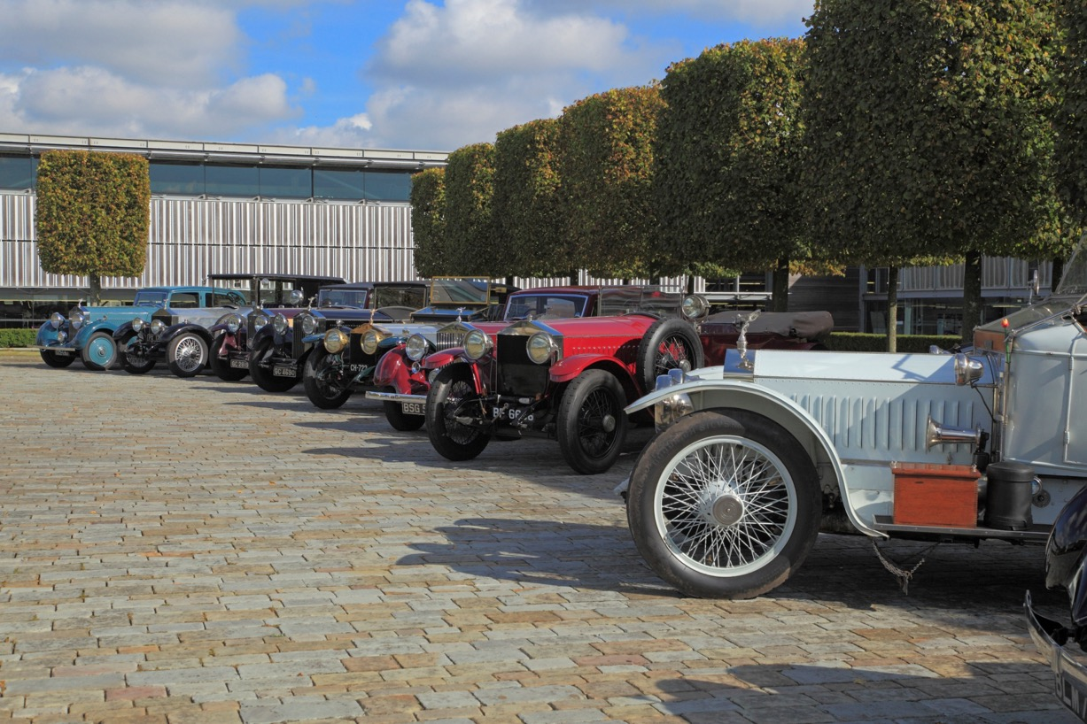
Membership:
All pre 1940 or a Select Few?

Slide 15
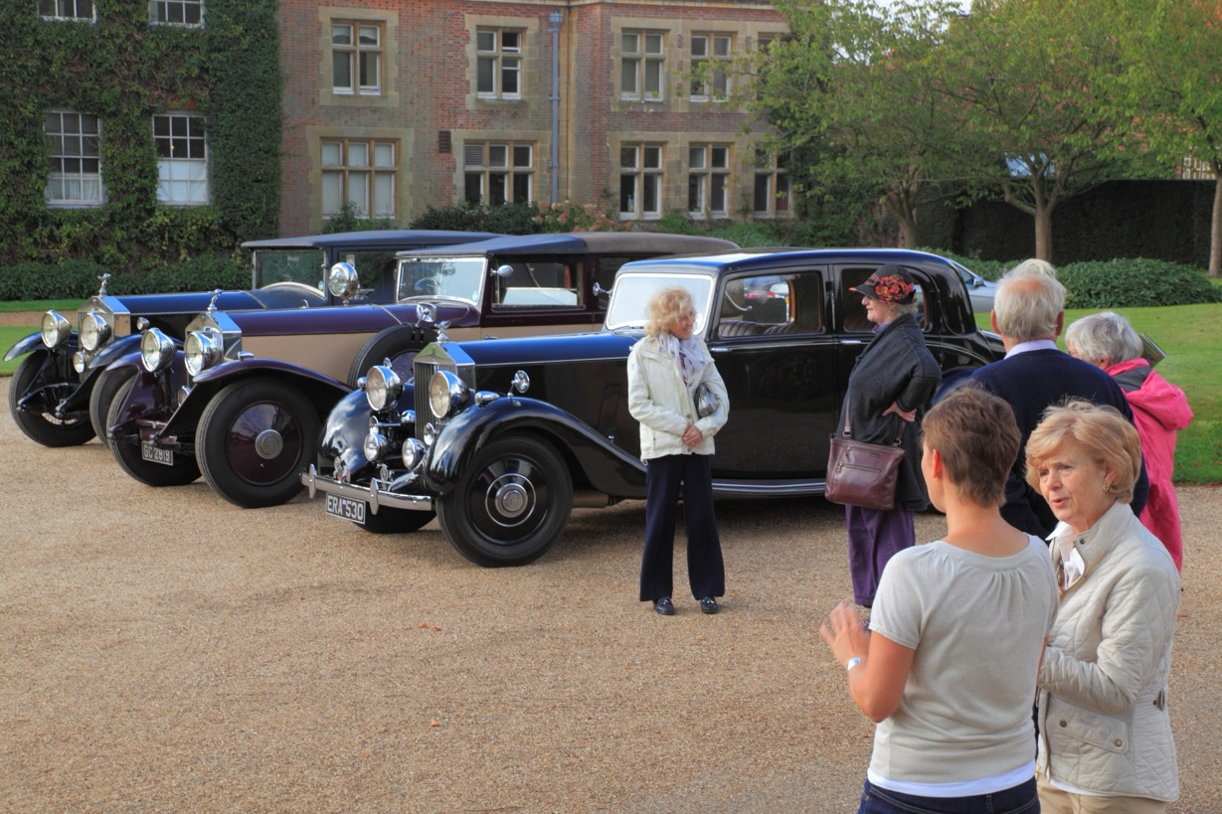
Membership:
More focus on some areas?

Slide 16
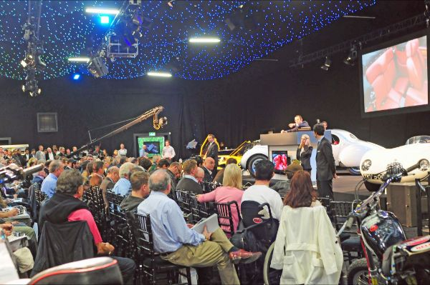
Membership:
How to capture younger members ?

Slide 17
Membership: Decisions
3.a aim to increase membership in the UK and on the Continent with the aim of becoming not just the oldest Rolls-Royce car club, but the principal Rolls-Royce car club for anyone using a pre-war Rolls-Royce?
3.b target particular types of models of Rolls-Royce where we are relatively lightly represented and that are not particularly well catered for elsewhere?
3.c aiming for a higher percentage of owners of 20/25 and the later 25/30 & Wraiths?
3.d Should we accept the fact that younger owners of classic cars buy other kinds
of car or should we try harder to attract these younger affluent potential members by a combination of events and communications emphasising a life style that is fun, elegant, contains challenge and has perhaps a bit more youth and beauty than they expect?

Slide 18
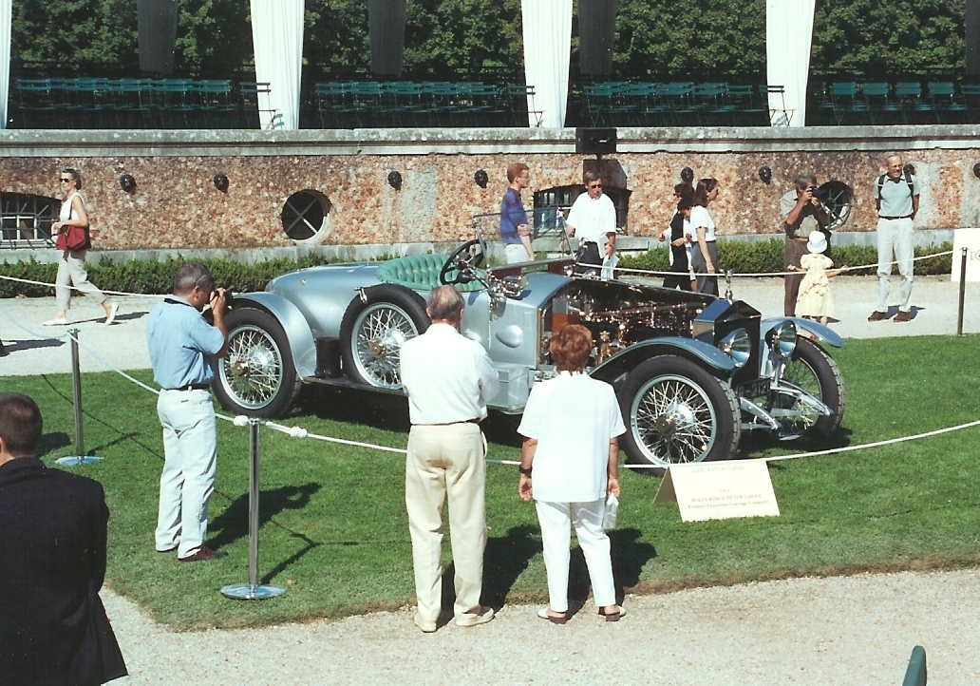
Should we Promote The Club More
- At Prestige Events?

Slide 19
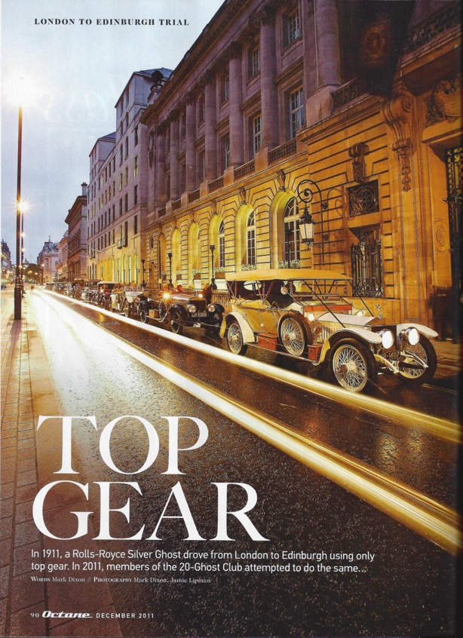
Should we seek out – Magazine Coverage?

Slide 20
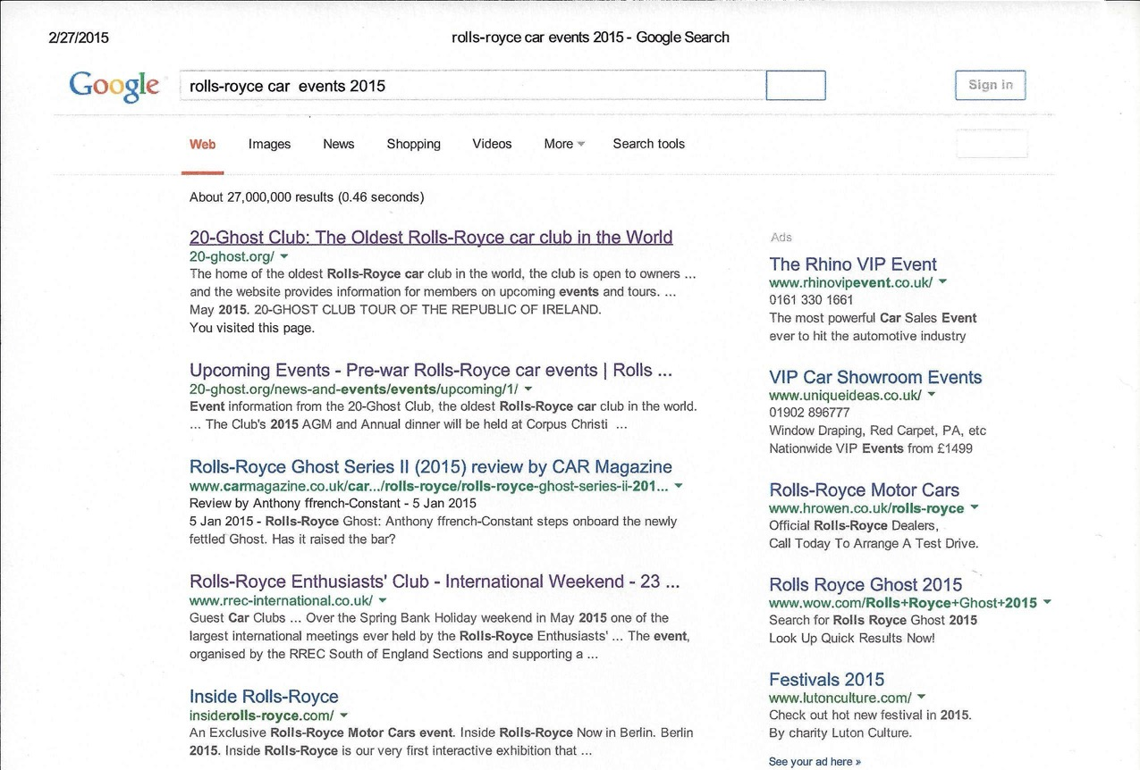
Promotion- Google/ Internet ?

Slide 21
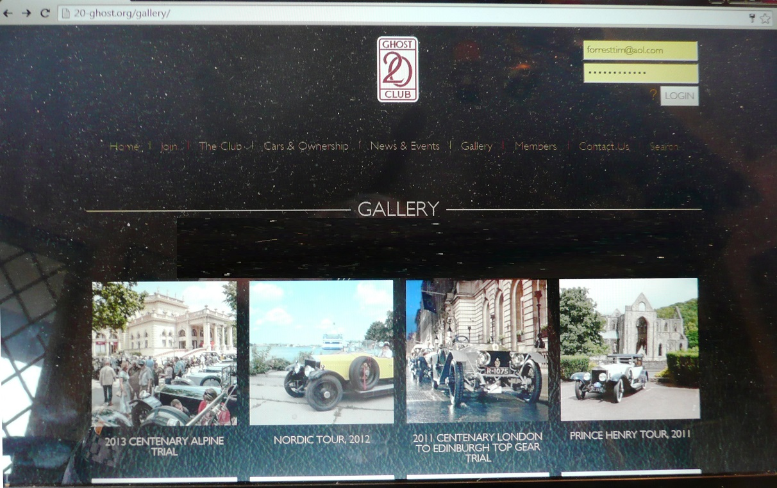
How to get the best from the Website?

Slide 22
Promotion- Decisions
4.a use every available opportunity to promote the Club?
4.b aim to display ourselves at prestigious public events?
4.c use Web site to show coverage of cars in Action?
4.d investigate press agents specialising in classic cars?
4.e arrange with third parties to promote the Club in exchange for promotion through the Website.
4.f a presence on social media or add a forum to website

Slide 23
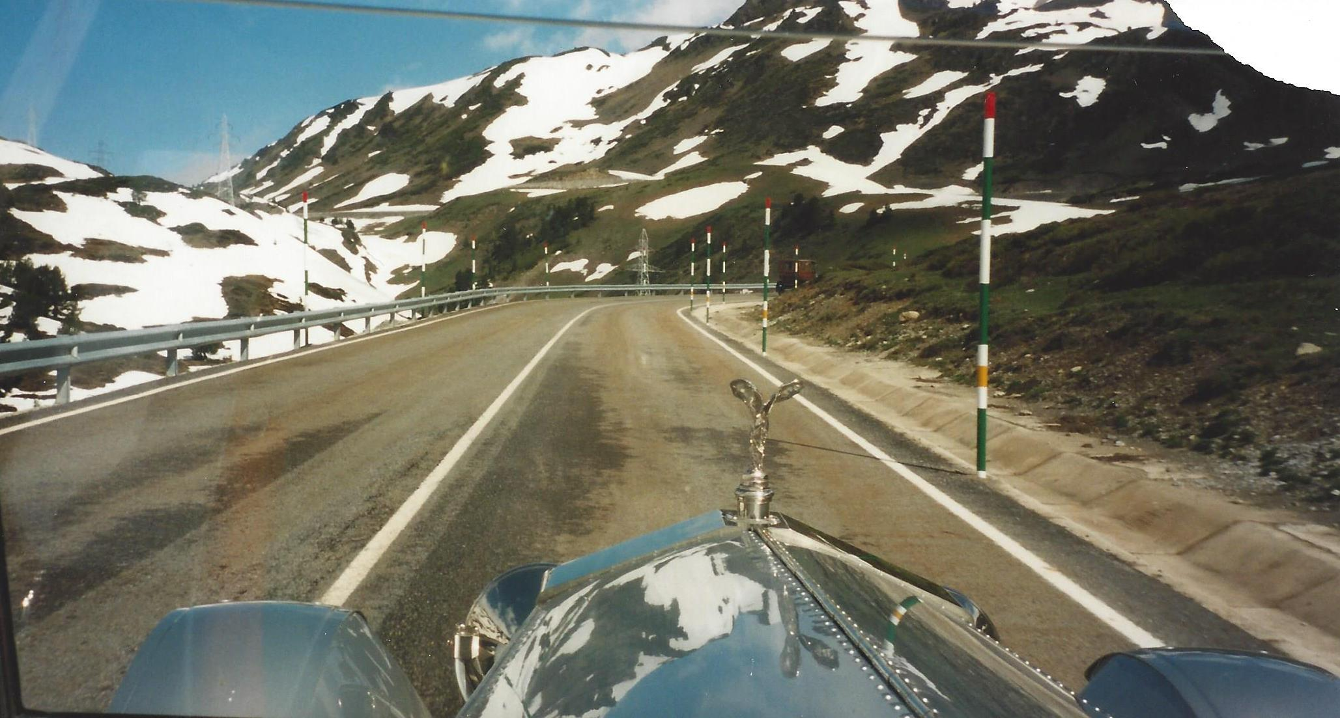
News & Record recomendations
– More Action Photos

Slide 24
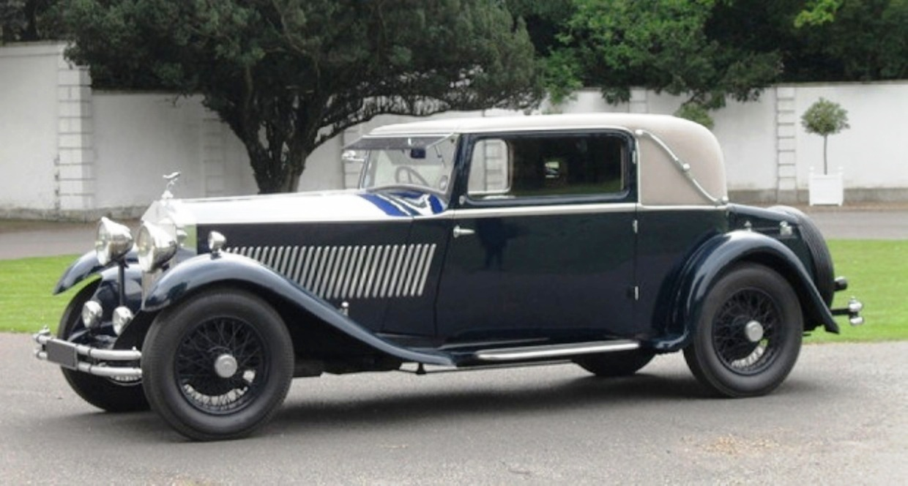
N & R Changes
– Greater Focus on Small HP

Slide 25
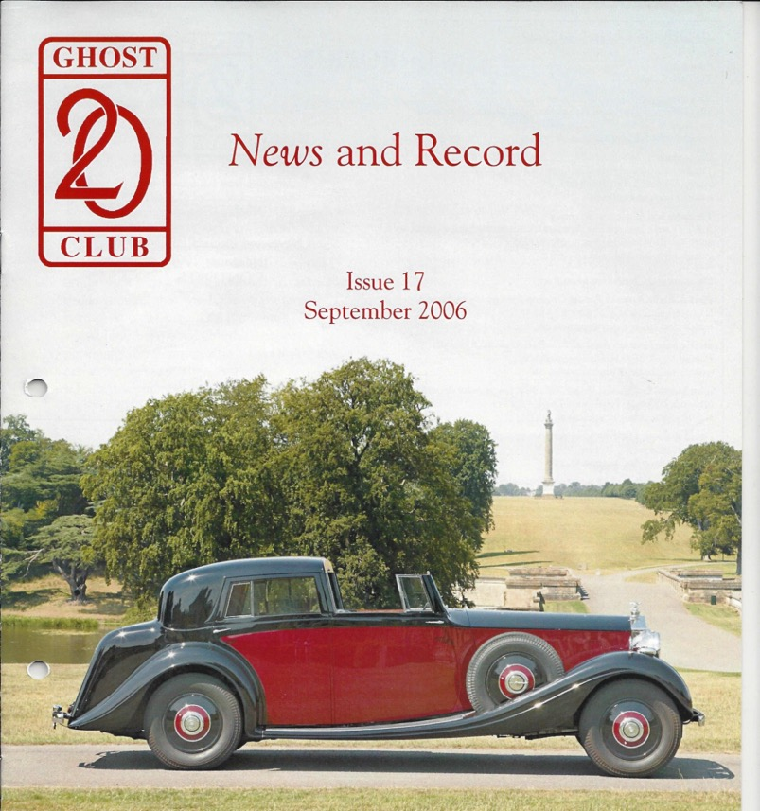
N& R Changes
– Cover with an interesting car

Slide 26
N & R Decisions
5.a published in mid-February, early June and late October?
5.b a little more emphasis on small horsepower cars?
5.c each issue an article on cars and their owners and a technical article?
5.d one article on each major event (rally, AGM etc) per issue –
5.e interviews conducted by the Editor with car owners
5.f if an article is not supplied by a deadline, it should be held over until the next issue or, if need be, dropped?
5.g What is the policy on advertising?
Plus
5.h in covering events use more photographs of cars in action rather than in a line up.
5.i should we Include photo’s of New Members cars?

Slide 27
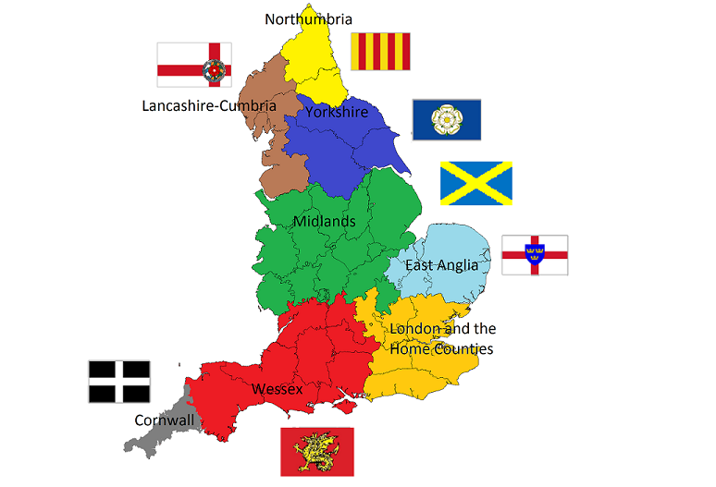
Management & Organisation
Central or slightly federal ?

Slide 28

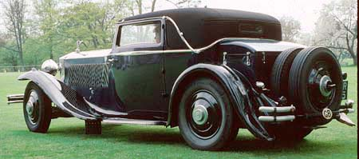
Management & Organisation
All in one or part by model ?

Slide 29

Management & Organisation
Move Commercials to 21st Century

Slide 30
Management & Organisation
Decisions
6.a Does our centralist approach need to change in order to manage a wider range of events, promote the club more and meet the needs of a wider cross section of the membership?
6.b Should we consider assigning specific responsibilities to members of the Committee to cover key operational functions?
6. c Would appointing members to organise local events be a good way of enabling more one day or weekend events take place for specific groups of our members?
6.d should we appoint 20-Ghost Club Ambassadors to represent the Club in certain European Countries where our membership has potential to grow?
6 e Can we move towards electronic banking and accept member payments in selected foreign currencies or by card?

Slide 31
The 20-Ghost Club Limited
The Oldest Rolls-Royce Car Club in the World
Strategy Review
Thank You for your Input!

